Slide 1

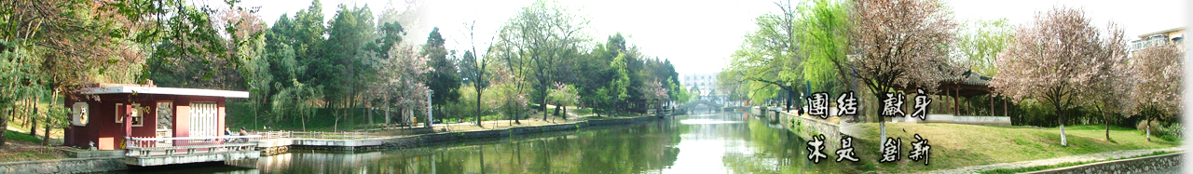
7 Sensor Value Normalization
EOE Postgraduate Courses
Multi-sensor Data Fusion
wangjingqi@njust.edu.cn

Slide 2
Contents
7.1 Introduction
7.2 Binarization
7.3 Parametric Normalization Functions
7.4 Fuzzy Normalization Functions
7.5 Ranking
7.6 Conversion to Probabilities

Slide 3
7.1 Introduction
Definition
Sensor value normalization （传感器数值标准化）is defined as the conversion of all sensor output values to a common scale.
Criteria to classify the scales
Nature of Scale. ⎯⎯ the basic mathematical properties of the scales.
E.g., bounded and linearly ordered→ comparable
The choice of scale has consequences on the combination operations which are allowed. E.g., numerical operators → only accommodate numerical values, “min” or “max” can also deal with ordinal values.
Homogeneity. （一致性） ⎯⎯ whether, or not, the sensors are measuring same thing.
E.g. A logical sensor: measuring the degree to which a test object resembles a reference object. → output a distance, or a dissimilarity coefficient, or output a proximity measure, or a similarity coefficient.

Slide 4
Statistical Distribution. ⎯⎯ the empirical statistical distribution followed by the sensor values when applied to a given population.
Semantics. （语义学） ⎯⎯ semantics, or meaning, of a scale e. g. probabilistic, possibilistic, utility or degree-of-similarity.
It is often thought that problems of incommensurability will not occur if all the scales have the same semantics.
In particular, problems of incommensurability may occur when we use “utility” or “degree of-similarity” scales. The reason is that utility and degree-of-similarity scales do not have a clear and well-defined meaning.

Slide 5
Example 7.1. Similarity Measures for Virtual Screening（虚拟筛选）.
Using a computational scoring scheme to rank molecules in decreasing order of probability of activity.
Similarity searching ⎯ taking a molecule (normally called the target compound) with the required activity and then searching a database to find molecules that are structurally most similar to it.
Two principal components of a molecular similarity measure :
(1) The structural representation used to characterize the molecules ;
(2) the similarity coefficient used to compute the degree of resemblance between pairs of such representations.
molecular “fingerprints” （分子指纹）, binary vectors, encoding the presence, or absence, of sub-structural fragments within the molecule.

Slide 6
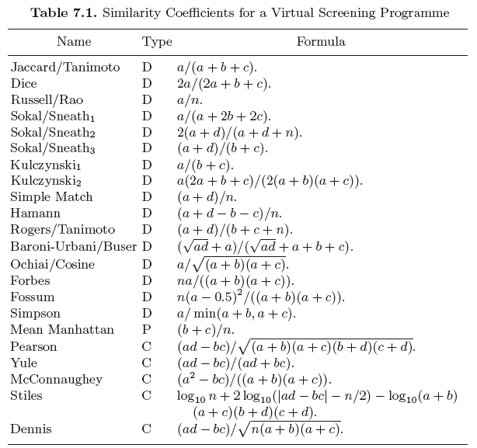
Similarity Coefficients
3 types:
“D”
- distance coefficients
“C”
- correlation coefficients
“P”
- proximity coefficient

Slide 7
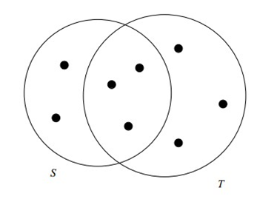


Jaccard
Jaccard coefficient
similarity between finite sample sets
Definition：the size of the intersection divided by the size of the union of the sample sets:
A
B
Jaccard distance
dissimilarity between sample sets, complementary to the Jaccard coefficient
subtracting the Jaccard coefficient from 1, or, dividing the difference of the sizes of the union and the intersection of two sets by the size of the union:

Slide 8


E.g. Similarity of asymmetric binary attributes
- Given two objects, A and B, each with n binary attributes
- The total number of each combination of attributes for both A and B are specified as follows:
  represents the total number of attributes where A and B both have a value of 1.
  represents the total number of attributes where the attribute of A is 0 and the attribute of B is 1.
  represents the total number of attributes where the attribute of A is 1 and the attribute of B is 0.
  represents the total number of attributes where A and B both have a value of 0.
Each attribute must fall into one of these four categories, meaning that
The Jaccard similarity coefficient, J, is given as
The Jaccard distance, d_{J}, is given as

Slide 9
7.1.1 Sensor Value Normalization
Mathematical expression
a set of logical sensors, S_{i}, i∈{1, 2, . . .,N}, make N measurements x_{i} on an object O.
The transformation is conducted by changing the scale and location parameters.
f — a parametric transformation function with scale and location parameters α and β and possibly other parameters γ, δ etc..
Fixed sensor value normalization. ⎯ parameters α, β, . . . , δ are learnt from measurements on a set of training samples D = x_{i}, i∈{1, 2, . . .,N}.
Adaptive sensor value normalization. ⎯ the transformation is estimated from the current measurement values.
Robustness. ⎯ insensitivity in the presence of outliers .
Efficiency. ⎯ the proximity of the obtained estimate to the optimal estimate when the distribution of the data is known.

Slide 10
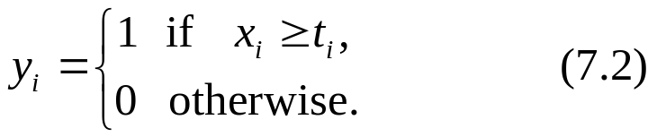
7.2 Binarization
Many different sensor measurements x_{i}, i∈{1, 2, …,N}, are made on the same object O. We threshold each x_{i} using a threshold t_{i} to obtain the corresponding normalized values yi,
simple & robust
The thresholds t_{i}, i∈{1, 2, . . .,N}, may be learnt or may be established on physical grounds.

Slide 11
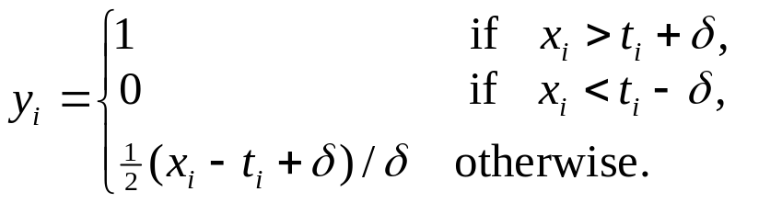
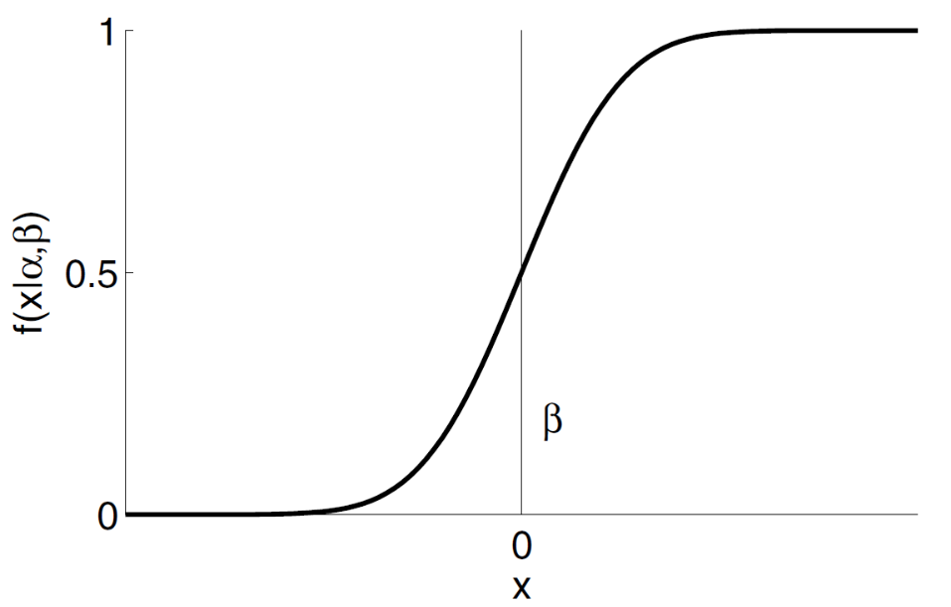
Example 7.2. “Soft” Binarization.
To reduce the impact of choosing an incorrect threshold, replace (7.2)
with a trimmed min-max transfer function (see Table 7.4):
with a sigmoid-like transfer function.
Fig. 7.1. Shows a Logistic sigmoid transfer function.

Slide 12
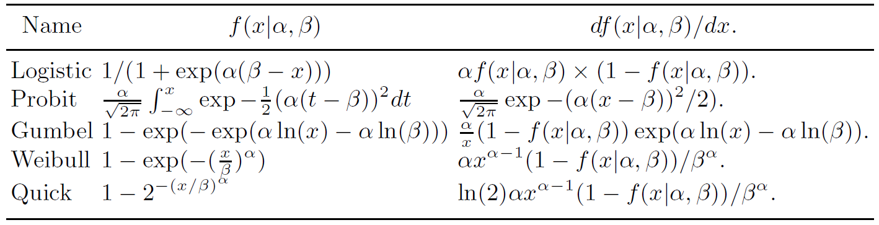
Example 7.3. Psychometric Transfer Functions .
Psychophysics explores the connection between physical stimuli and subjective human responses.
The psychometric transfer function, f(x|α, β), relates the intensity of the stimulus, x, to an observer’s response, y.
α — a scale parameter and β — a location parameter.
Sigmoid-like psychometric transfer functions & their slopes df (x|α, β)/dx
Table 7.2. Psychometric Transfer Functions f(x|α, β) and Slopes df (x|α, β)/dx

Slide 13
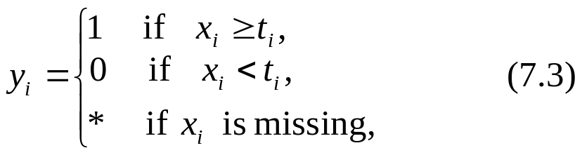
Censored binary scale
For a given object O, problems may arise if we do not have a complete set of N measurement values.
The reason ⎯ when binarization is performed, we do not differentiate between (1) y_{i} = 0 because x_{i} ≤ t_{i} and (2) y_{i} = 0 because no measurement value x_{i} is available.
E.G., the sensor S, making the measurement x_{i} , may have malfunctioned when the object O was being processed.
Definition of a censored binary scale
where ∗ is a special symbol which is handled differently from 0 and 1 by the data fusion algorithm.
Censored binary scales are widely used when the information concerning the x_{i} are subjective in nature.

Slide 14
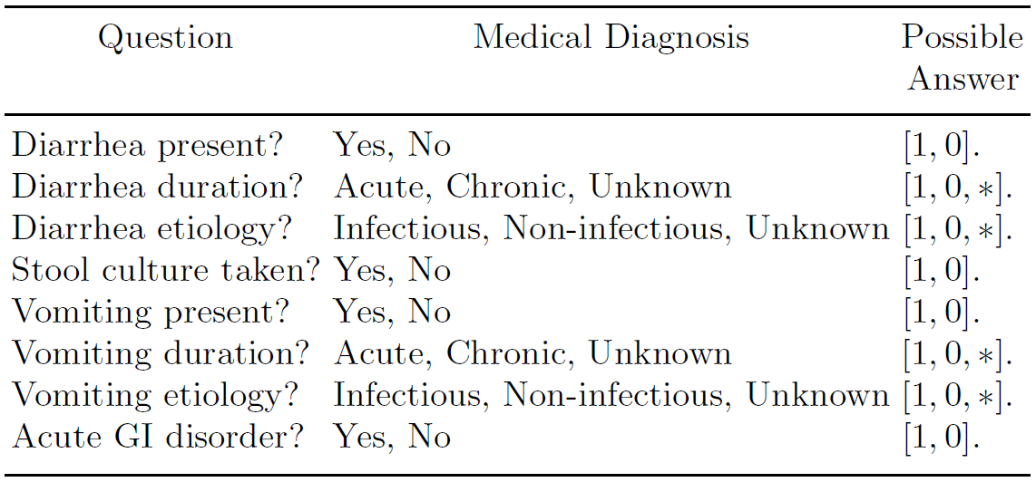
Example 7.4. Automatic Disease Classification: Syndromic Surveillance .
to ensure early detection of an epidemic(流行病) in a given population.
monitoring the temporal and spatial trends of a syndrome(综合症状), or a group of related symptoms or diseases, in the local population.
E.g., a censored questionnaire to monitor cases of acute gastrointestinal(肠胃疾病) syndrome which were admitted to the local hospital emergency departments.
Table 7.3. Questionnaire Used for Detecting Acute Gastrointestinal Syndrome

Slide 15
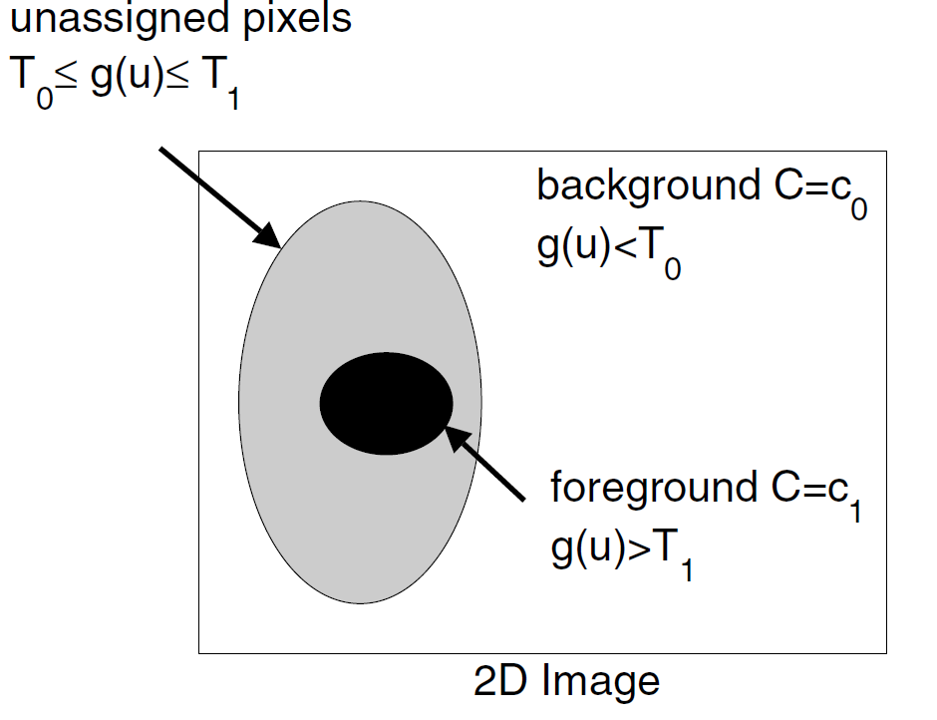
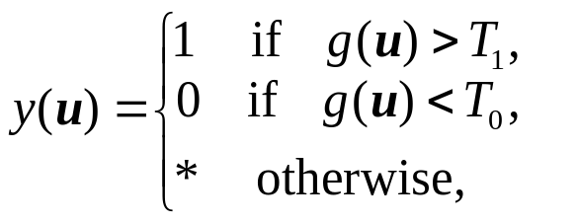
Application of censored binarization in image analysis
Example 7.5. Image Thresholding Using Kriging.
a 2D image consisting of two univariate populations: background (class C = c₀) and foreground (class C = c₁).
an initial (censored) labelling of the input image:
Fig. 7.2. A 2D image
where g(u) denotes the gray-level of the pixel u and T₀ and T₁ are two thresholds.
How to label the unassigned pixels (i.e. the pixels with T₀ ≤g(u) ≤ T₁)?

Slide 16
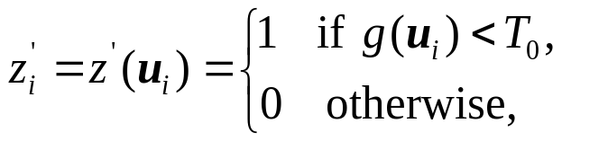
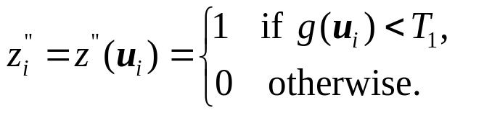
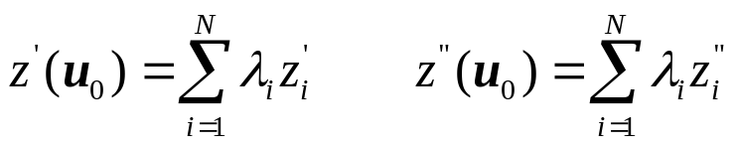
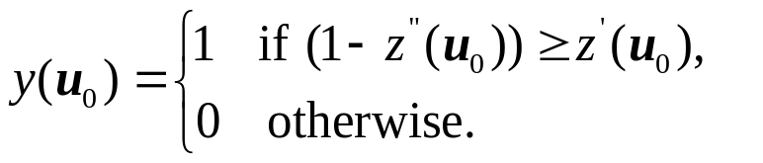
Label the unassigned pixels (i.e. the pixels with T₁ ≤g(u) ≤ T₂)
Let: u₀ — a given unassigned pixel; g_{i} = g(u_{i}), i∈{1, 2, . . .,N} — the gray-levels of the N nearest assigned pixels.
Given the y_{i} we generate two binary lists:
Calculate interpolated values z’(u₀) and z”(u₀) by performing ordinary Kriging on the z_{i}’ and z_{i}” lists:
Interpret z’(u₀) and (1-z”(u₀)) as the probabilities that g(u₀) belongs, respectively, to the background, y = 0, and to the foreground, y = 1.
the we choose the final classification of g(u₀) with the highest probability:

Slide 17
7.3 Parametric Normalization Functions
（参数化归一化函数）
The most common normalization technique is to use a parametric normalization function y = f(x|α, β, . . . , δ), whose parameters α, β, . . . , δ, are learnt from a training set D of labelled objects O_{i}, i∈{1, 2, . . .,N}.
Family of Psychometric Transfer Functions （心理测量学转换函数）
Table 7.2. Psychometric Transfer Functions f(x|α, β) and Slopes df (x|α, β)/dx

Slide 18
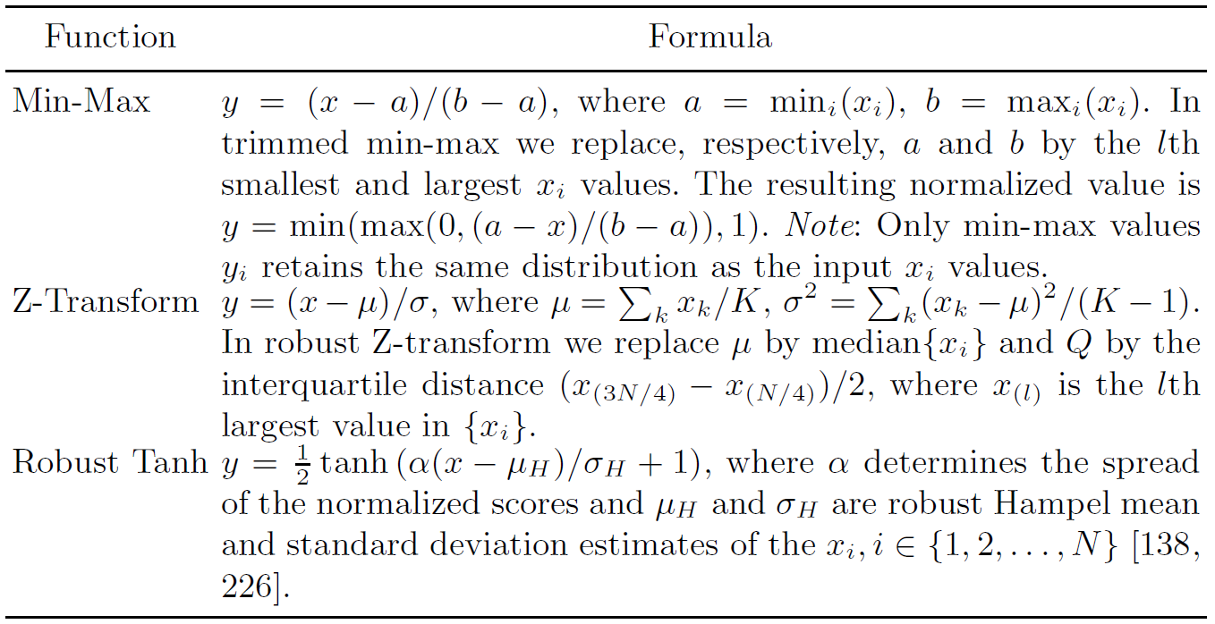
Additional parametric transfer functions.
Table 7.4. Parametric Normalization Functions
Note: Only the trimmed min-max, robust z-transform and robust tanh normalization functions are robust against outliers.

Slide 19
7.4 Fuzzy Normalization Functions（模糊归一化函数）
An input value x is converted into a vector of M components:
where y^{(m)} = μ_{m}(x) represents the degree to which x “belongs” to the mth membership —— membership function
μ_{m}(x), m∈{1, 2, . . .,M} ⎯ continuous, 0 ≤ μ_{m}(x) ≤ 1.
Note: In fuzzy logic there is no requirement that the components y^{(m)} should sum to one. In fact, Σ_{m} y^{(m)} can take any value between 0 and M.

Slide 20
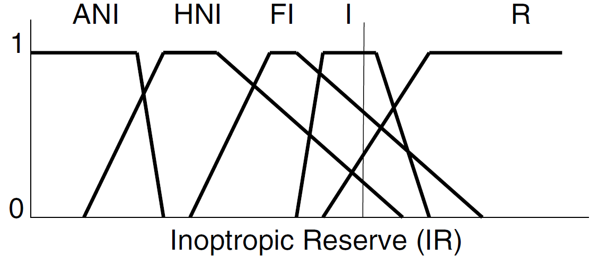
Example 7.6. Normalization of the Inotropic Reserve Using Fuzzy Logic
consider the fusion of the Inotropic Reserve (正性肌力储备IR) and the 18-fluorodeoxyglucose (氟脱氧葡萄糖FDG).
both variables were normalized by using fuzzy membership functions each of which was interpreted as a linguistic variable.
ANI —“Akinetic and No Improvement”,
HNI— “Hypokinetic with No Improvement”,
FI —“Function Improvement”,
I — “Ischemic”,
R —“Remote”
Fig. 7.3. Five membership functions μ_{i}(x) used to normalize the Inotropic Reserve (IR).
The thin vertical line shows a given value of IR = x which is converted to the vector y = (μ_{ANI}(x), μ_{HNI}(x), μ_{FI}(x), μ_{I}(x), μ_{R}(x)) =(0.0, 0.15, 0.55, 1.0, 0.35).

Slide 21
7.5 Ranking （排序）
An example of adaptive score normalization ⎯ based on the current input measurements and not require a training set D.
advantages : simple and fast to implement, linear, robust against outliers and can be applied to all kinds of input information without the need to make additional assumptions regarding their distributions etc.
Definition
Suppose the input data consists of N objects O_{i}, i∈{1, 2, . . .,N} → On each O_{i} , we make a measurements x_{i}. Then the corresponding rank is r_{i},

Slide 22
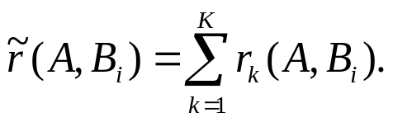
Example 7.7. Fusing Similarity Coefficients in Virtual Screening Programme.
match a bio-active target structure A against a database of molecules B_{i}, i∈{1, 2, . . .,N}, using any one of several different similarity operators S_{k}, k∈{1, 2, . . .,K}.
x_{k}(A,B_{i}) ⎯ the similarity value measured by the kth operator S_{k}.
Before fusing together all K values x_{k}(A,B_{i}), k∈{1, 2, . . .,K}, normalize them by ranking.
Let r_{k}(A,B_{i}) denote the rank of x_{k}(A,B_{i}), then the fused similarity value, ~r(A,B_{i}), is defined as the sum of the r_{k}(A,B_{i}):

Slide 23
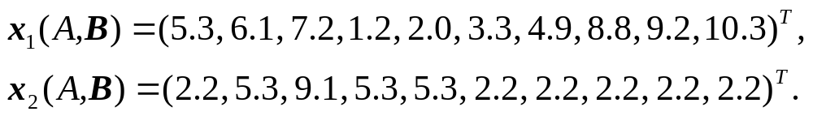
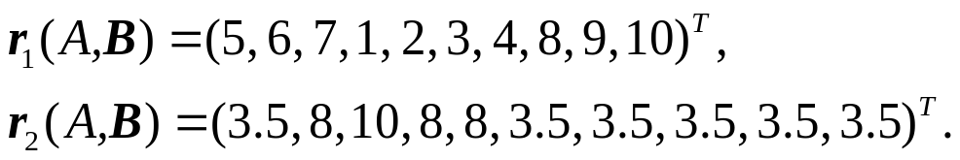

Example 7.8. Fusing Similarity Coefficients: A Numerical Example. .
A vector of similarity values,
The corresponding rank vectors,
The fused similarity rank vector,
where

Slide 24
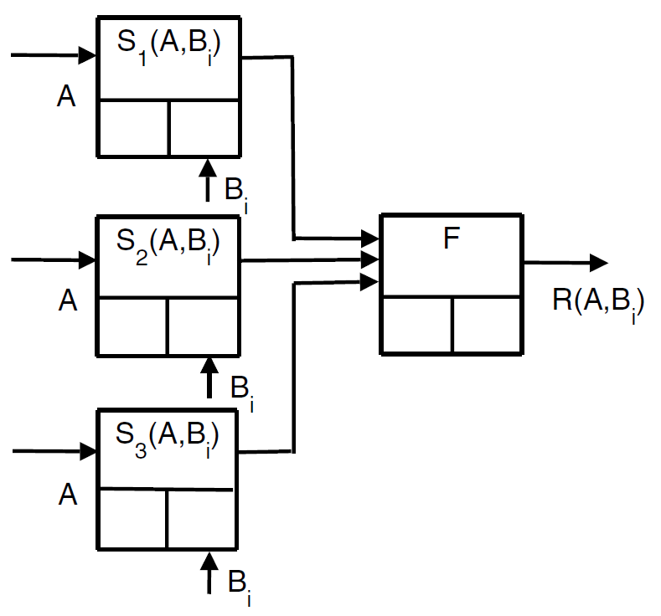
A parallel network of fusion
Fig. 7.4. A parallel arrangement of three fusion cells S_{k}(A,B_{i}), k ∈ {1, 2, 3}, which perform ranking of the samples B_{i} according to different criteria. The output from F are the fused similarity ranks.

Slide 25
Example 7.9. Remote Sensing .
For remotely sensed data, temporal sequences accurately indicate environmental changes, assuming that the input data is radiometrically consistent for all scenes .
Factors contributing to the potential inconsistency in including surface condition, illumination geometry, sensor calibration, observation geometry and atmospheric condition.
Radiometric normalization technique may be used to correct for data inconsistencies resulting from many different effects.
Image normalization is carried out in one step by converting image values to ordinal ranks ⎯ assign each pixel a new value based on its reflectance value, relative to all other pixels
Pixel ranking allows images to be simply and efficiently normalized and processed for changes with minimal a priori knowledge.
In general, for small pictures, pixel ranking is an effective image normalization technique. It is, however, less effective on very large digital images because in this case we obtain many tied ranks.

Slide 26
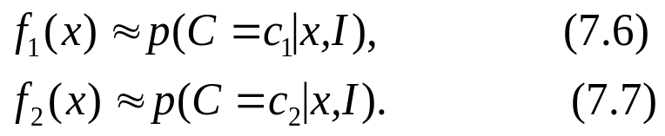
7.6 Conversion to Probabilities（转变成概率）
Sensor measurement x, and its corresponding normalized value y, don’t have the same physical properties. In particular, y ⎯ an a posteriori probability.
Suppose that: all objects O belong to either a class C = c₁ or to a class C = c₂. x is the measured value of O.
To find two functions y = f₁(x) and y = f₂(x) such that f_{k}(x) closely approximates the a posteriori probability density function p(C = c_{k}|x, I):
Since, p(C = c₁|x, I) = 1 − p(C = c₂|x, I) , (7.8)
only f₂(x) should be calculated.
- f₂(x) → f(x)
Note. The formulas which follow all assume balanced training sets, i.e. the number of objects in each training set are equal.

Slide 27
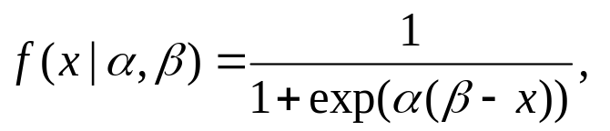
7.6.1 Platt Calibration（Platt 校准）
Using a parametric function, f(x|α, β, . . . , δ), with a given shape. Parameters α, β, . . . , δ, are learned using a database D of labeled objects O_{i}, i ∈{1, 2, . . .,N}.
Example 7.10. Converting SVM Scores into Probability Estimates .
Convert a measured value x, derived from a support vector machine (SVM), into an estimate of p(C = c₂|x, I) by assuming a sigmoid function for f(x|α, β):
where α and β are two parameters adjustable for maximum likelihood.

Slide 28
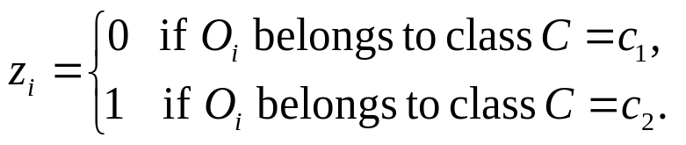
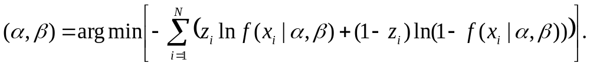
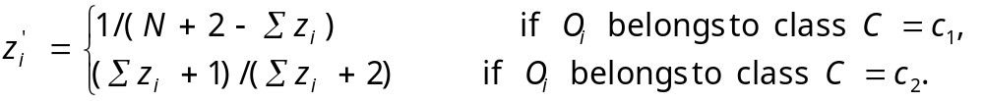
Suppose O_{i} has a value x_{i} and a class label z_{i}, where
Find the parameters α and β by minimizing the negative log likelihood of the data set D:
Overfitting —— may happen if the number of O_{i} which belong to C = c₁ or to C = c₂ is too low. The effects of overfitting can be mitigated by using modified labels, z’_{i}, in the above minimization procedure, where

Slide 29
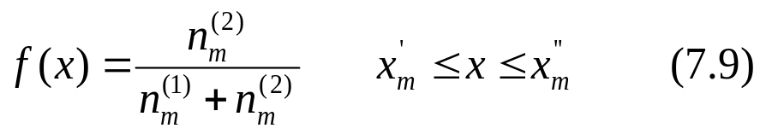
7.6.2 Binning
frequency histogram（频率直方图） or binning ⎯ a non-parametric method.
Suppose O_{i}, i∈{1, 2, . . .,N}, in D are arranged in order of increasing value, i.e. x₁ ≤ x₂ ≤ . . . ≤ x_{N}.
x_{i} are divided into M non-overlapping subsets of called bins, B_{m}, i ∈{1, 2, . . .,M}. For each bin we compute lower and upper boundary values, x’_{m} and x’’_{m}.
f(x) = p(C = c₂|x, I) is defined as
where n^{(k)}_{m} is the number of C = c_{k} objects O_{i}, i∈{1, 2, . . .,N}, which fall in the mth bin B_{m}.

Slide 30
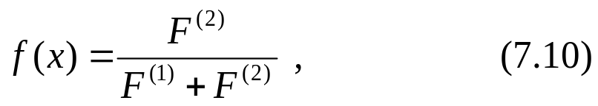
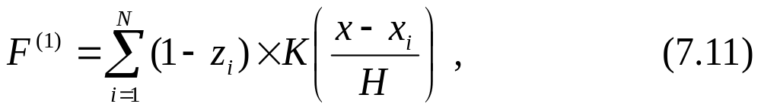
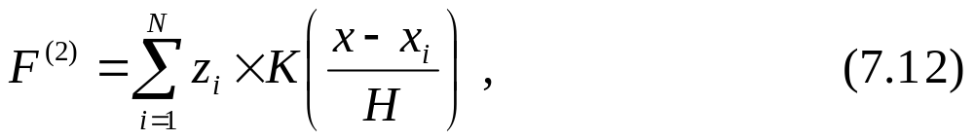
7.6.3 Kernels（核函数）
When continuous bins, or kernels, is used to calculate the pdf f(x), the equation corresponding to (7.9) is
where
K is a bounded non-negative function satisfying ∫ K(x)dx = 1
H is a positive number usually called the kernel bandwidth.

Slide 31
7.6.4 Isotonic Regression
In isotonic regression, we do not know the shape of the function y = f(x) except that it belongs to the class of isotonic, or non-decreasing, functions.
Function y = f(x) from scores into probabilities is isotonic, or non-decreasing.
Pair-adjacent violators (PAV) algorithm — find the stepwise-constant isotonic function that best fits the data according to a mean-squared error criterion.

Slide 32
Example 7.11. Isotonic Regression: Pair-Adjacent Violator Algorithm .
O_{i}, i∈{1, 2, . . .,N} ⎯ the training samples arranged such that the measurement values are in order of increasing value, i. e. x₁ ≤ x₂ ≤ …≤ x_{N}.
f∗(x) ⎯ the sought after isotonic function.
f(x_{i}) = z_{i},
If f is already isotonic → f∗ = f.
otherwise: for pair-adjacent violators x_{l}−1 and x_{l} : f(x_{l−1}) > f(x_{l}).
→ The values of f(x_{l−1}) and f(x_{l}) are then replaced by their average
If this new set of N − 1 values is isotonic,
then f∗(x_{l−1}) = f∗(x_{l}) = (f(x_{l−1}) + f(x_{l}))/2
Otherwise f∗(x_{l}) = f(x_{l}).
This process is repeated using the new values until an isotonic set of values is obtained.

Slide 33
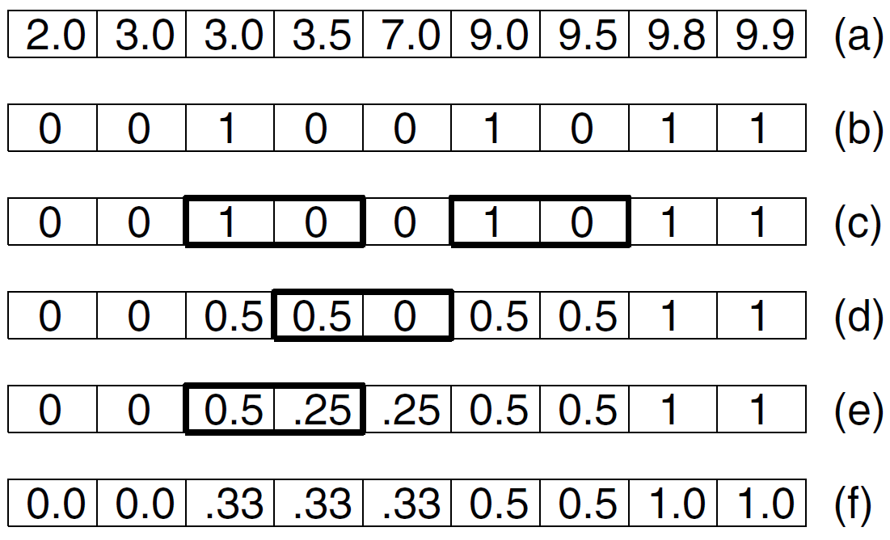
Fig. 7.5. The Pair-Adjacent Violator (PAV) algorithm in action.
Shows the training samples O_{i} arranged in order of increasing value x_{i}.
Shows class label z_{i} value for each sample O_{i}.
Boxes with heavy margins show the adjacent samples which violate isotonicity.
(d) and (e) Shows two iterations of the PAV algorithm in which we average the labels of the adjacent samples which violate isotonicity.
(f) Shows the final isotonic function f∗(x)..

Slide 34
7.6.5 Multi-Class Probability Estimates
For K classes c_{k}, k∈{1, 2, …, K}, find a multidimensional function f(x) such that f(x) closely approximates the a posteriori probability density function p({c_{k}}|x, I):
f(x) represents a multidimensional mapping from one K dimensional space to another K-dimensional space.
reduce the multi-class problem into K(K−1)/2 binary, or two-class, problems → combine the binary probability estimates using a voting or other similar algorithm.

Slide 35
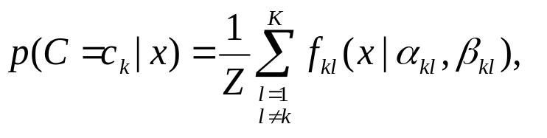

Example 7.12. Multi-Class Probability Estimates Using a Voting Algorithm.
Consider a multi-class probability estimate involving K classes c_{k}, k∈{1, 2, . . .,K}. Let f_{kl}(x|α_{kl}, β_{kl}) denote a probabilistic calibration curve for classes c_{k}, c_{l}, l > k.
The curves f_{kl} may be obtained directly from the classification algorithm or may be estimated using any one of the methods listed in Sect. 7.6. Then the a posteriori probabilities p(c_{k}|x, I) for an input x are:
where f_{kl}(x|α_{kl}, β_{kl}) = 1 − f_{lk} (x|α_{lk}, β_{lk})
and
is a normalization factor which ensures the a posteriori probabilities
sum to one.

Slide 36
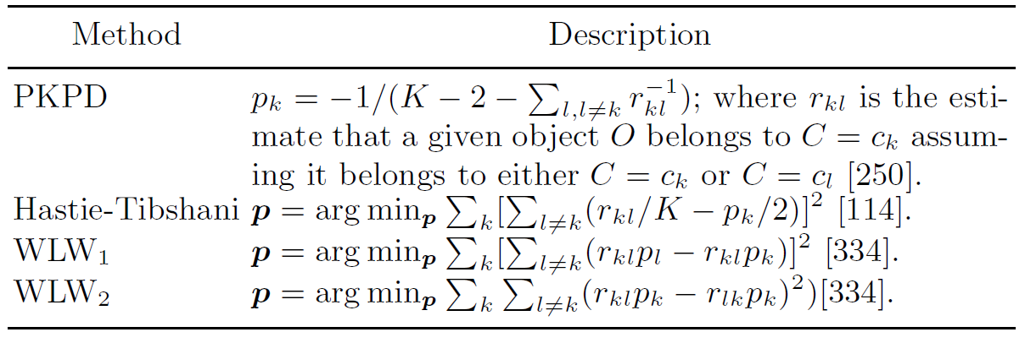
Additional methods for estimating the multi-class probabilities
p = (p₁, p₂,. . . , p_{K})^{T}.
Table 7.5. Methods for Estimating Multi-Class Probabilities p

Slide 37

Thank you for your attention!

